Slide 1


REGIONAL CENTER
DESIGN GUIDELINES UPDATE
Marlee Cawthorn
City Architect – DMD
Notes:
Thank President Dillon & Commissioners
Hello everyone. My name is Marlee Cawthorn, City Architect with DMD
Excited to be here today to discuss an update to the Regional Center Design Guidelines

Slide 2

OVERVIEW
Regional Center – Summary & Goals
Review Process
Guiding Principles & Values
Special Requirements Areas
Boundary

Slide 3
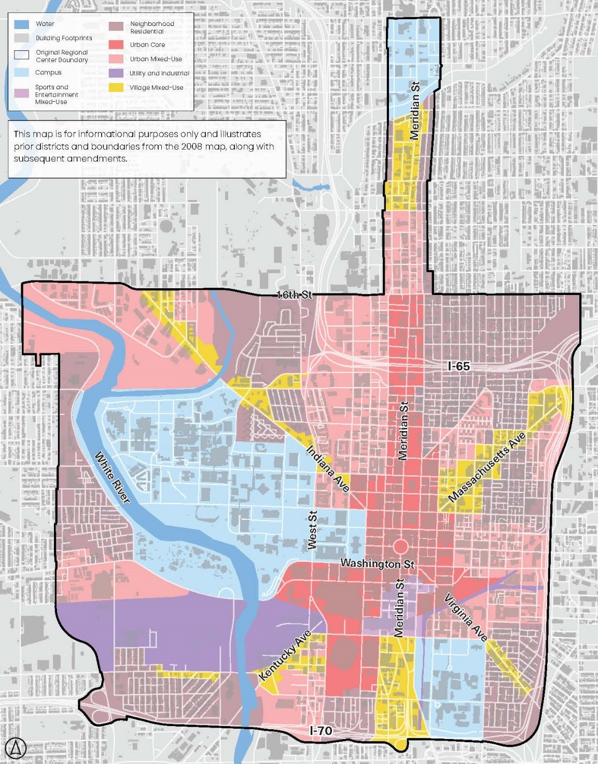
WHAT IS REGIONAL CENTER?
Secondary overlay district on top of the primary zoning classifications
Originally adopted in 1970; Last updated in 2008
Properties protected by IHPC are exempt from Regional Center review
Single-family and duplex homes are reviewed with Infill Housing Guidelines.
Notes:
Serves as a Design Review process for all development projects in the heart of our urban core
No change to Infill Housing Guidelines (2021)
Enhance the urban environment & prioritize the pedestrian experience.
Establishes a community standard for urban design.
Encourage safety and walkability in our most dense communities.
Facilitate the design process by letting developers know in advance the basis of staff’s evaluation.
Improve the consistency of the Regional Center review process.
Less subjective review by staff.

Slide 4

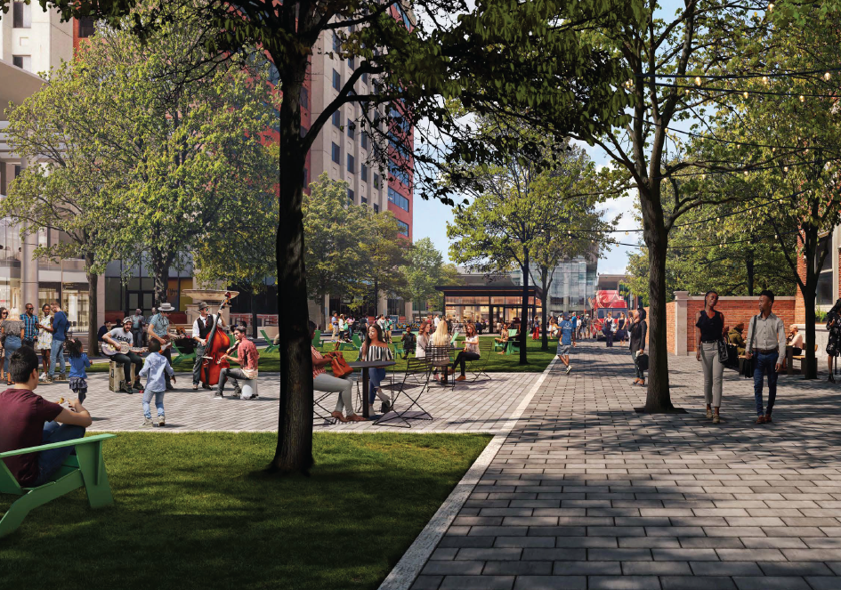
2026 UPDATE GOALS
Revise Regional Center boundary.
Establish Special Requirements Areas.
Modernize standards, graphics and format.

Slide 5
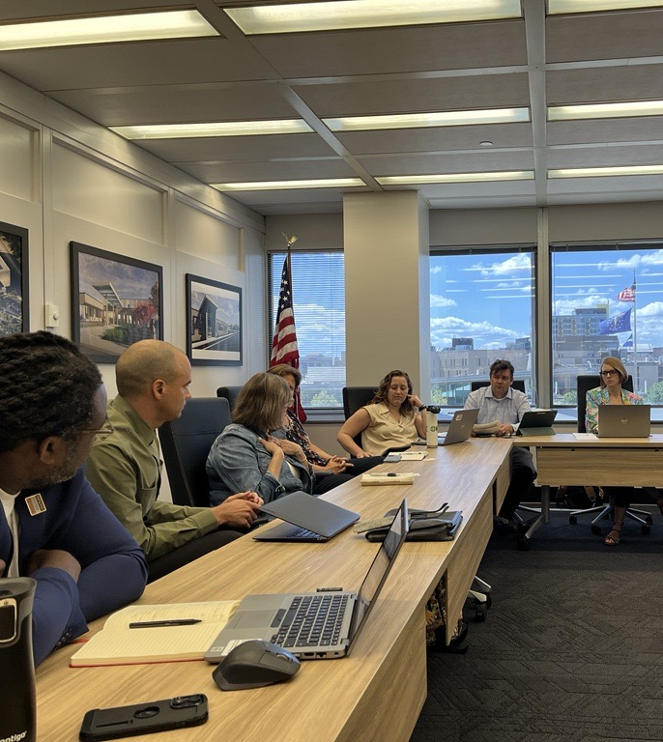
ENGAGEMENT
Process began in Spring 2024.
Advisory Committee
  Visionary leaders to strategize on overall goals and values
  18 individuals
  Three meetings (two remaining)
Steering Committee
  Technical experts to deep dive into specific content areas
  15 individuals
  Three meetings
Notes:
Advisory – Downtown Indy, Visit Indy, CIB, Indy Chamber, CICF, Citizens Energy Group, IU Health, 16 Tech
Steering – IndyGo, Health & Hospital Corp, developers like Hendricks and TWG, some architects, landscape architects, and engineers doing work downtown
ALSO – We have done outreach to all the councilors that would be impacted by these updates
(if asked - Ratio, Blackline, Anderson Bohlander, REA, HNTB)
Engaged: President Osili, Barth, Gibson, Brown, Jones -- Additionally: Evans, Roberts

Slide 6
ENGAGEMENT
Focus Groups (14)
  Architecture
  Infrastructure
  Transportation
  Law
  Real Estate
  Arts
  Culture
  Environmental
  Development
  Health & Safety
  Visioning
  Stakeholders
  Historic Preservation
  Public Sector
Notes:
Each one hour long
Engaged over 100 different organizations even before the public comment period

Slide 7




GUIDING PRINCIPLES & VALUES
Notes:
DON'T ELABORATE – READ GOALS ONLY
People – Visual Interest, Vibrant Public Spaces, Incorporating Nature
Community – Intentional Public Art, Embracing Iconic Assets, Inclusive Access
Connectivity - Pedestrian-Oriented Infrastructure, Linking Destinations, Alignment with Adopted Plans
Future - Sustainable Design, Energy Efficiency, Adaptable Infrastructure, Partnering with Anchor Institutions

Slide 8
BOUNDARY -
EXISTING
Boundary largely untouched since 1970.
Urban core has grown.
Connect to Meridian Street Preservation Corridor.

Slide 9
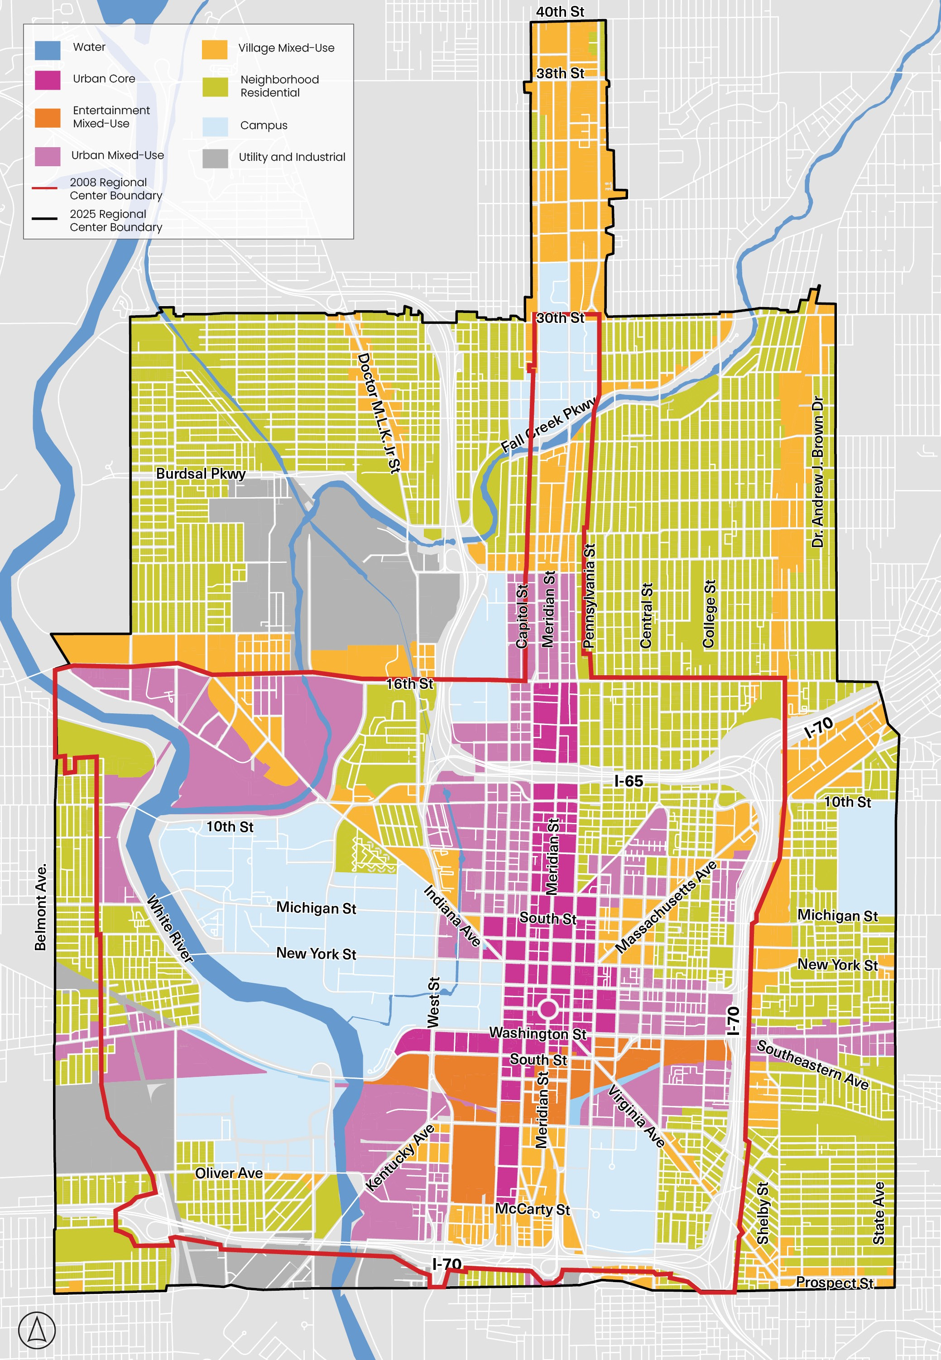
BOUNDARY -
PROPOSED
PROPOSED
North
  30th St
  North "leg" to 40th St
East
  Dr. A J Brown Ave
  State Ave
South
  Morris / Prospect
West
  Belmont Ave
EXISTING
Notes:
Moves away from using the interstates as boundaries to help reconnect neighborhoods on each side

Slide 10
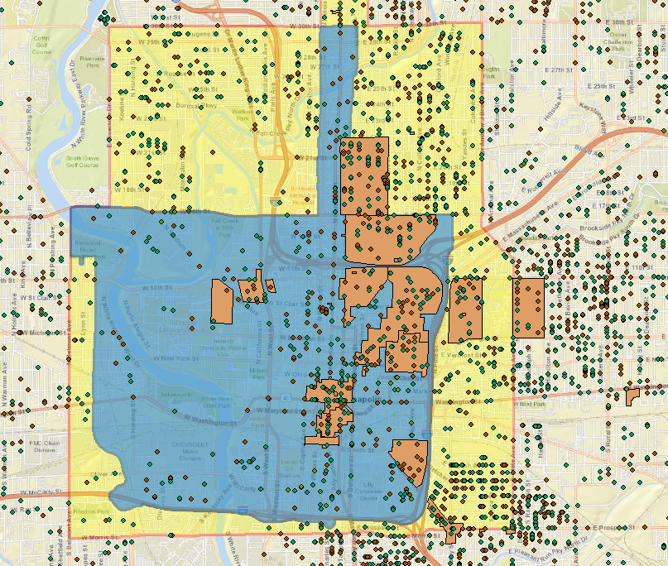
BOUNDARY -
PERMIT DATA
2018 – Brown dots
2023 – Teal dots
Notes:
STRUCTURAL PERMIT DATA from pre and post Covid to understand trends in development patterns
Orange zones – IHPC districts
Blue is existing, yellow is proposed today

Slide 11
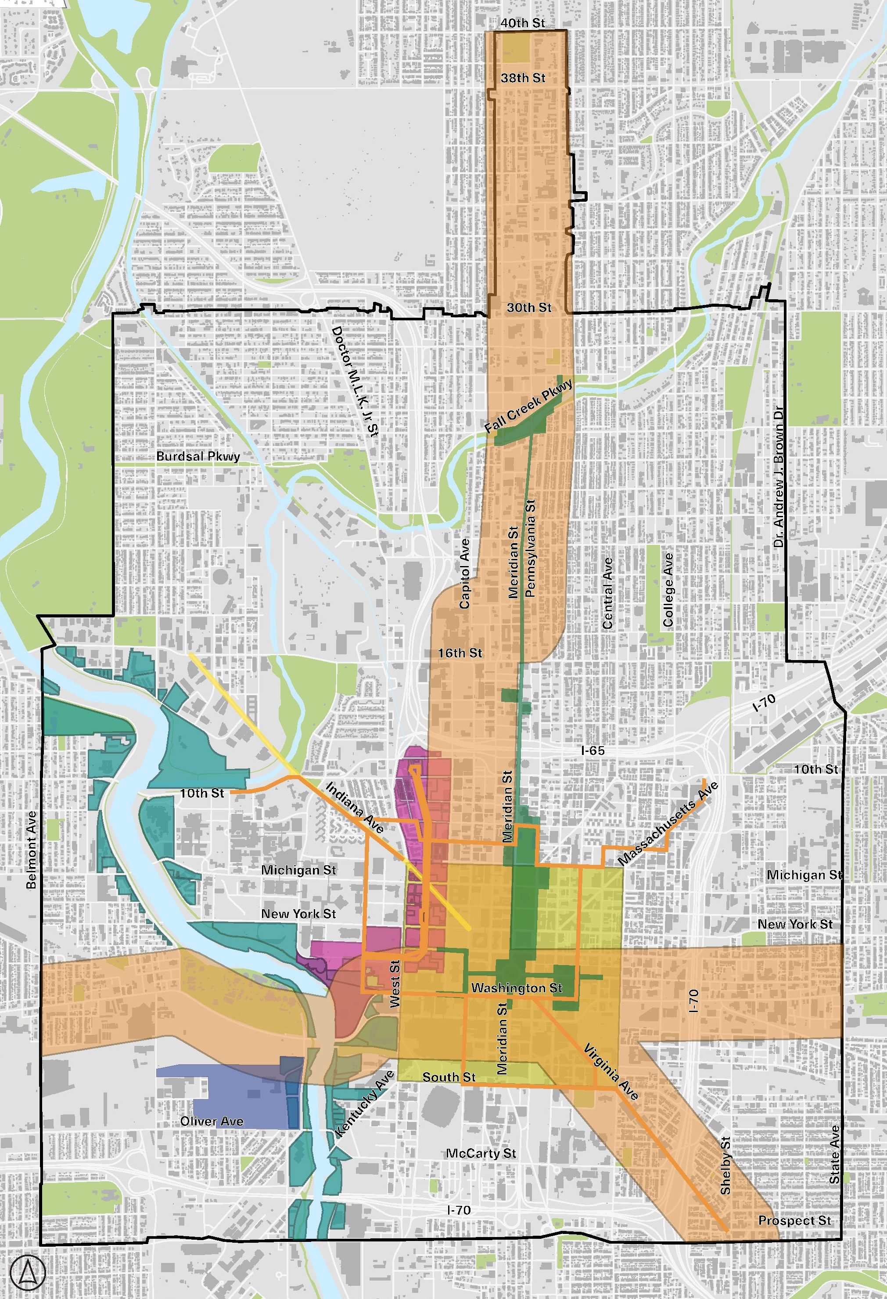
SPECIAL REQUIREMENTS AREAS
White River
Indianapolis Cultural Trail
Indiana Ave
Canal Walk
Urban and Scenic View Corridors
One Health Innovation District at the Levee
Mile Square Plan
Transit Oriented Development (TOD)
Notes:
EIGHT Special Requirements Areas for designated parts of the Regional Center that have unique features and help define the character and identity of Indianapolis
Special characteristics and some specific guidelines, an elevated review process, and increased opportunity for stakeholder and neighborhood engagement

Slide 12
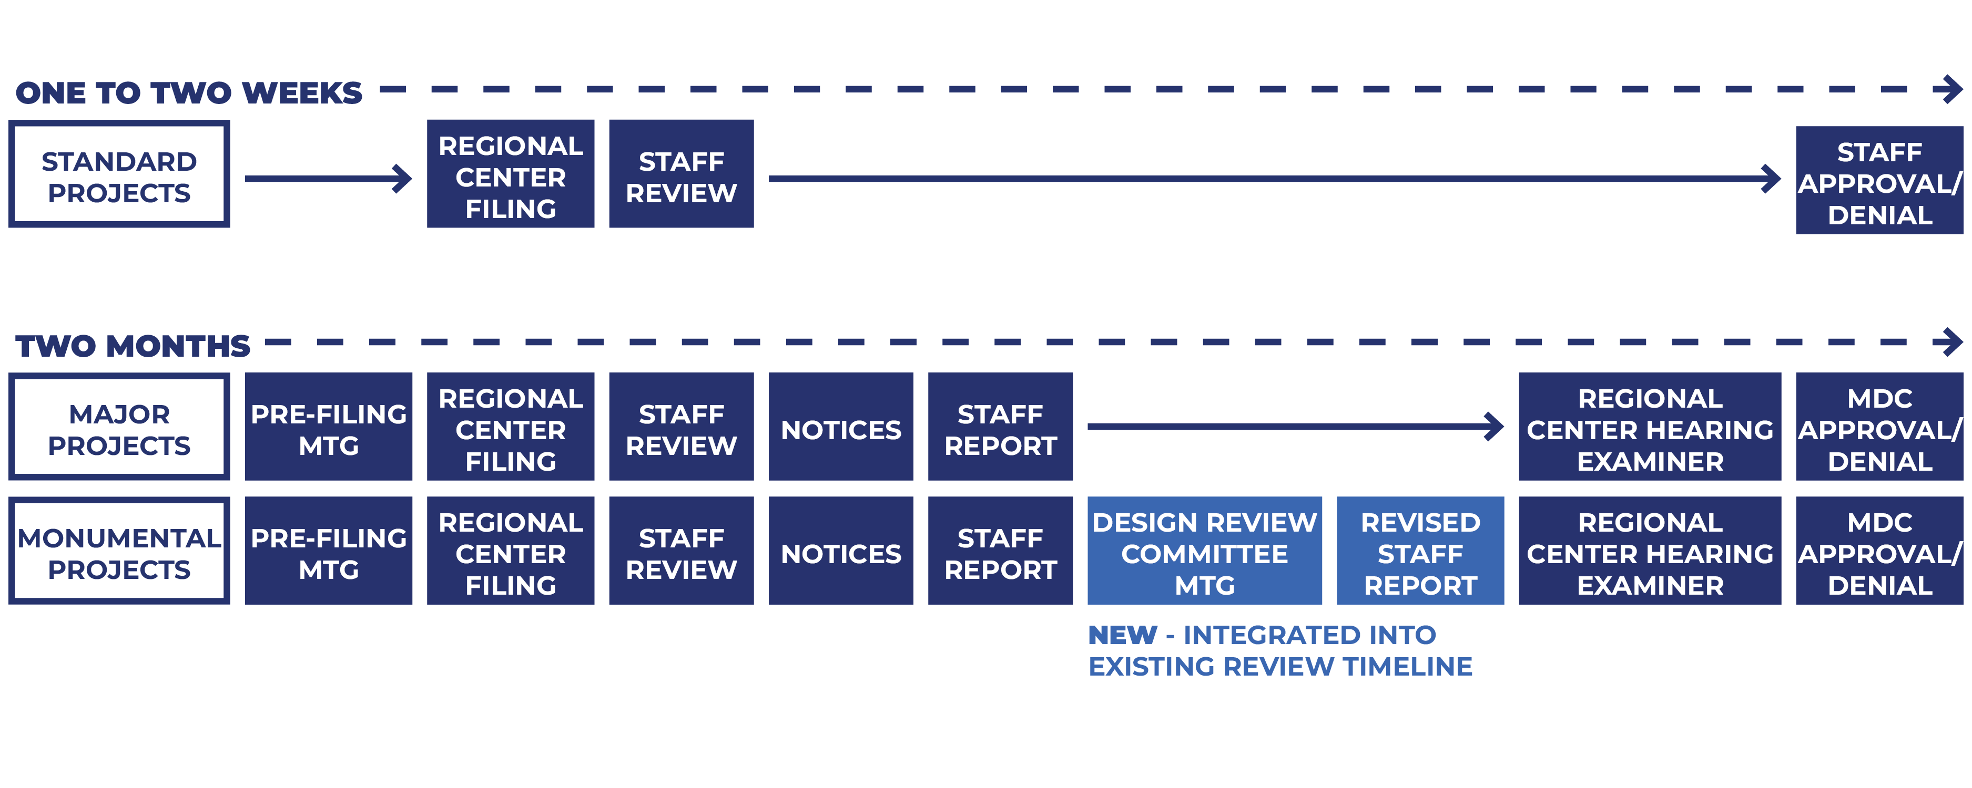
REVIEW PROCESS
Notes:
Standard projects – 1 to 2 weeks, reviewed at a staff level - One & two story homes, new construction under 10,000 sf, minor exterior renovations, signage
Major and Monumental projects – go the Regional Center Hearing Examiner for a recommendation that is shared with this Commission for approval or denial. This process takes roughly two months now and that will remain unchanged moving forward.
Major – New-construction and site changes over 10,000 sf, larger exterior façade renovations, developments with parking structures visible from the ROW, demolition of historically contributing structures (not protected by IHPC)
Monumental – New-construction over 100,000 sf, site changes over 5 acres, Projects within Special Requirements Areas meeting one or more Major Project evaluation criteria

Slide 13
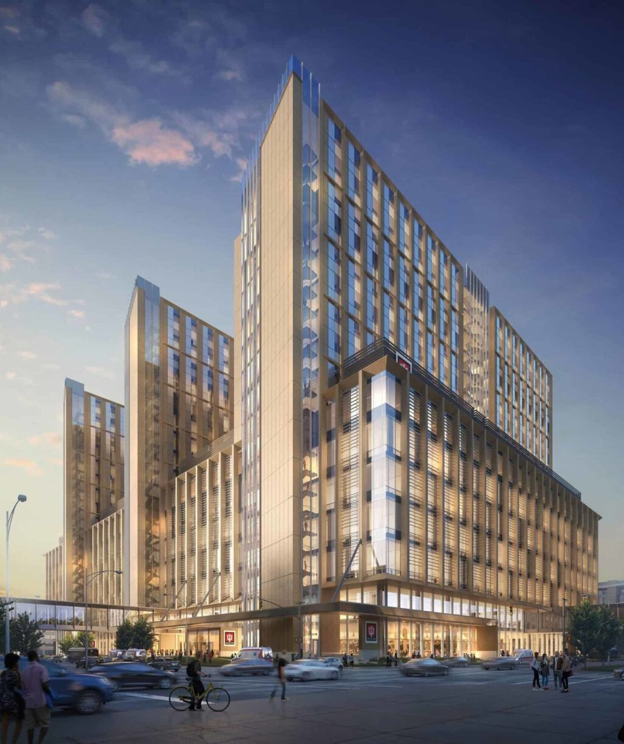
DESIGN REVIEW COMMITTEE
  Technical Advisory Committee
  9 MDC-appointed members:
    4 design/development professionals + City Architect
    4 representatives from various Special Requirements Areas
  Provides a recommendation to the Hearing Examiner, who provides ultimate recommendation to the MDC
  Integrate review into existing two-month timeline
Notes:
For Monumental Projects - new, highest tier of review - would require the project team to present the project to a new Design Review Committee
Based on project scale and location in a Special Requirement Area
Architects, landscape architects, planners, urban designers, preservationists, real estate or economic development professionals – those that are familiar with working downtown, having subject matter expertise
City Architect
Representatives from the various Special Requirements Areas – if asked, Downtown Indy Alliance, Cultural Trail
WHY???
VERY COMPLICATED PROJECTS, REQUIRE HIGH LEVEL OF TECHNICAL EXPERTISE,
NEED KEY STAKEHOLDERS TO HAVE EYES ON THESE PROJECTS SO WE WANT TO MAKE SURE WE GET THEM RIGHT
WE NEED THE SUPPORT OF THESE SUBJECT MATTER EXPERTS TO MAKE BETTER PROJECTS
Offers a structured forum for a wide range of professionals to provide input and collaborate to achieve a successful project
Earlier, more active dialogue through comprehensive review that can help catch issues early and reduce issues later.

Slide 14
DESIGN REVIEW COMMITTEE
Peer cities with Design Review Committees (separate from historic review):
Seattle, WA ​
Atlanta, GA​
Columbus, OH​
Cleveland, OH​
Asheville, NC​
Milwaukee, WI​
Jacksonville, FL
Miami, FL​
Boise, ID​
Charleston, SC​
Ann Arbor, MI​
Denver, CO ​
Providence, RI​
Louisville, KY
Philadelphia, PA​
Pittsburgh, PA​
Boston, MA​
Nashville, TN​
Knoxville, TN​
Madison, WI​
Memphis, TN
Fort Wayne, IN
Dallas, TX
Berkeley, CA
Baltimore, MD
Birmingham, AL
Oklahoma City, OK
Des Moines, IA
Notes:
Best practice research – we are one of the few remaining cities of one our scale that does not have a similar committee established

Slide 15

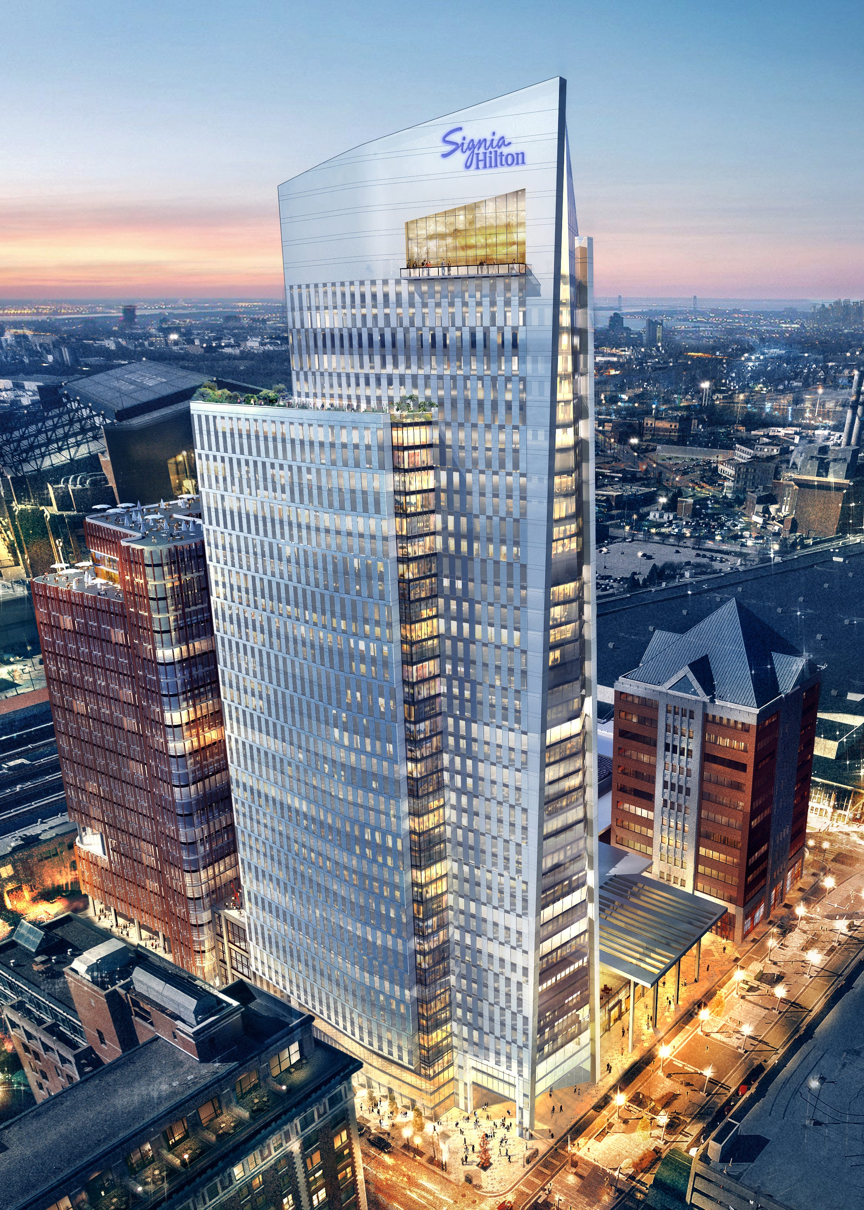
30-DAY PUBLIC COMMENT PERIOD
Public comment portal
  Visit indy.konveio.com and create an account to provide comment
Press release
Social media
One-pager for public distribution
  Mayor's Neighborhood Advocates
  City-County Councilors
  Neighborhood organizations
  Advisory and Steering Committee members
  Focus Group members

Slide 16
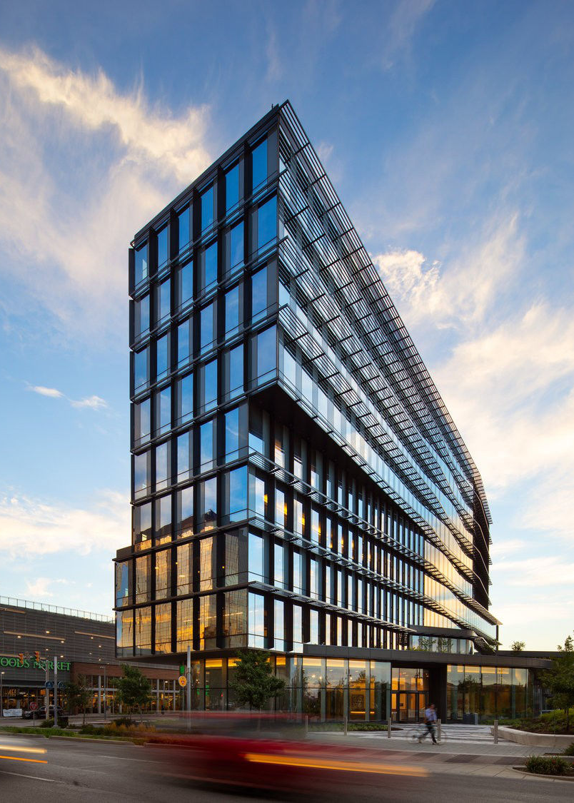
ANTICIPATED TIMELINE
30-Day Public Comment Period: November 5 - December 5, 2025
Final Guidelines from Consultants: January 2026
Legislative Process: Q1 2026
Effective Date: Q2 2026
Notes:
Staff will present again in early 2026 when we introduce the guidelines amendment with additional details.

Slide 17
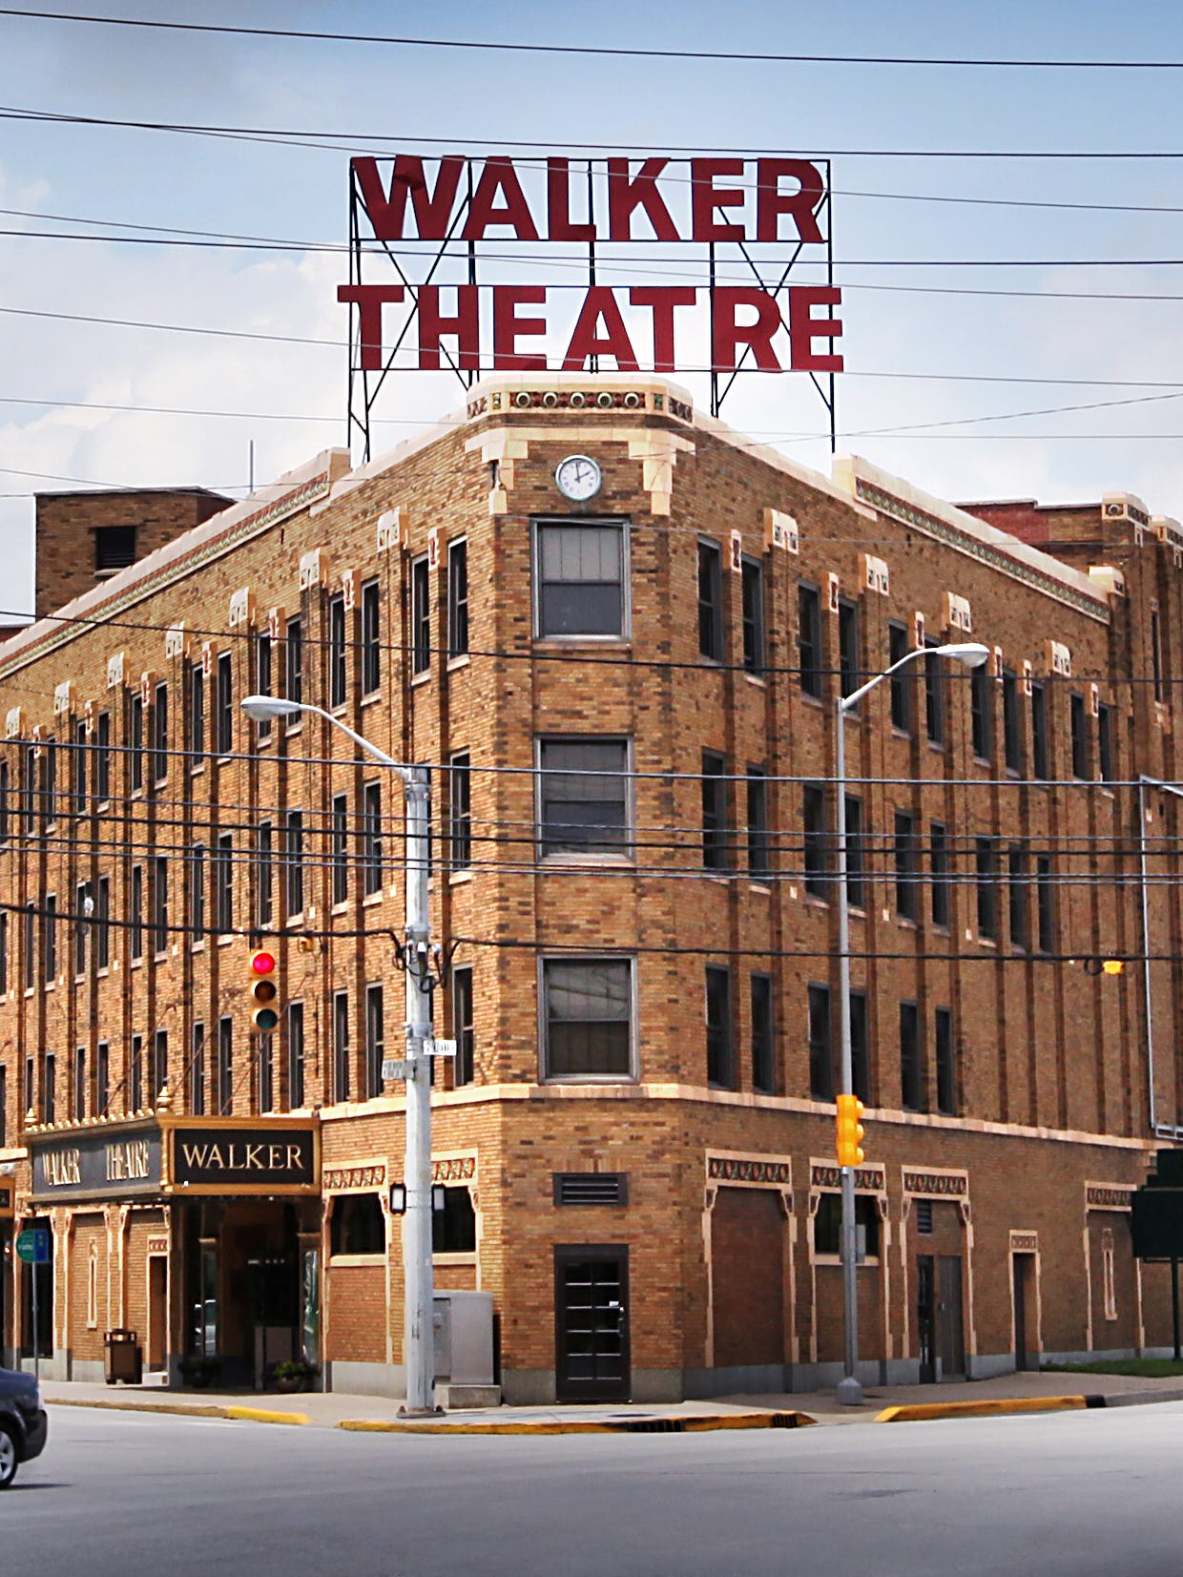
INDIANA AVE
Special Requirements Area
Finalizing the Certified Strategic Plan with MKSK & Brian Hurd (Resolution today)
DMD plans to complete this planning process through next year
Notes:
After this Plan is completed, we would come back to you with an amendment to include the area-specific guidelines in the RC document

Slide 18
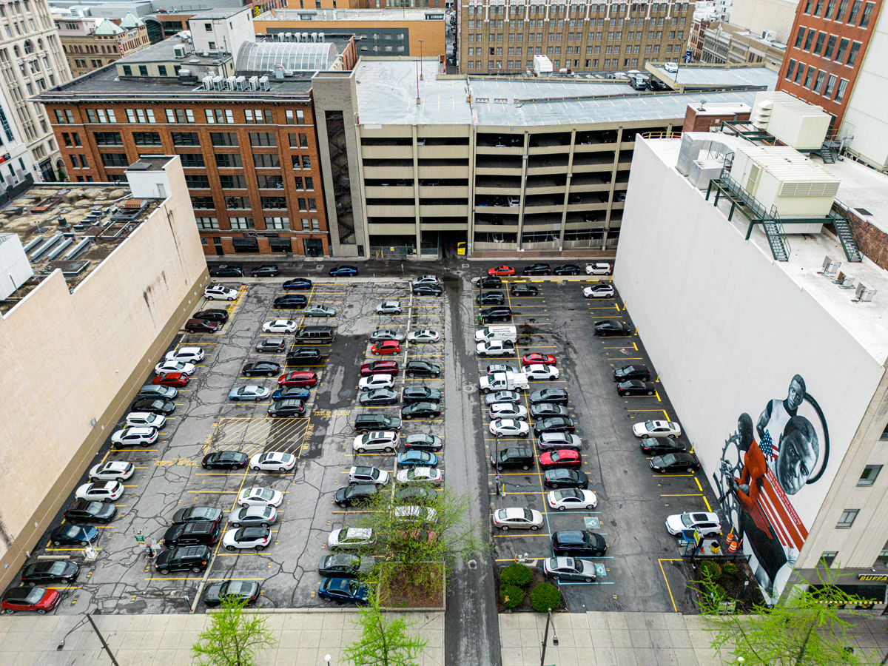
PARKING
Parking Inventory & Utilization Study
  Joint effort with DPW
  RFQ to be released
Areas to be studied:
  Regional Center
  Select dense neighborhood centers
Notes:
Parking requirements were a consistent topic of conversation in our stakeholder meetings
These discussions have led us to the decision to undergo a larger parking inventory and utilization study for the RC and other dense neighborhood centers in Marion County like Broad Ripple, Irvington
An RFQ, which will be in partnership with DPW, will be released next week
WE ARE NOT CHANGING OUR PARKING REGULATIONS AT THIS TIME, NEED MORE INFORMATION BEFORE WE CAN MAKE AN INFORMED POLICY DECISION
We will have more information on this when we enter into an agreement with a contractor to do this study in the future

Slide 19
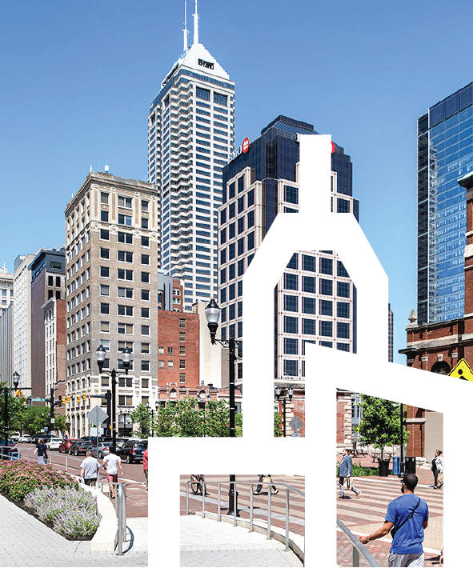
QUESTIONS?
Marlee Cawthorn
City Architect
Marlee.Cawthorn@indy.gov
Notes:
Thank you for your time today
Happy to take any questions

